Slide 1
REVIEW* of Statistics and Distributions
Note: the examples in this lecture can be found in Files/Jupyter Notebooks/Lecture 18.ipynb
Eric Prebys
Phy 118
Winter 2024
* I hope!

Slide 2
Probabilities
At the microscopic level, everything in physics is governed by probabilities.
When statistics become large enough, the uncertainties become small enough that probable outcomes become virtual certainties
This is how casinos make money!
In this course, we will analyze some of the statistical properties most often encountered in physics.

Slide 3
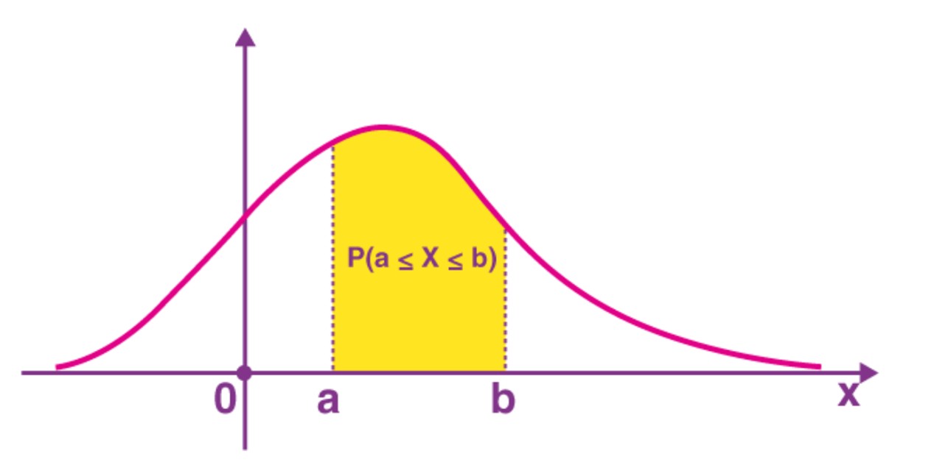
Probability Distributions
In general, we can characterize a probability by a “Probability Distribution Density Function” (PDF). In one dimension, this is defined as
Probability of being between x and x+dx
Probability of being between a and b is
Normalization:

Slide 4
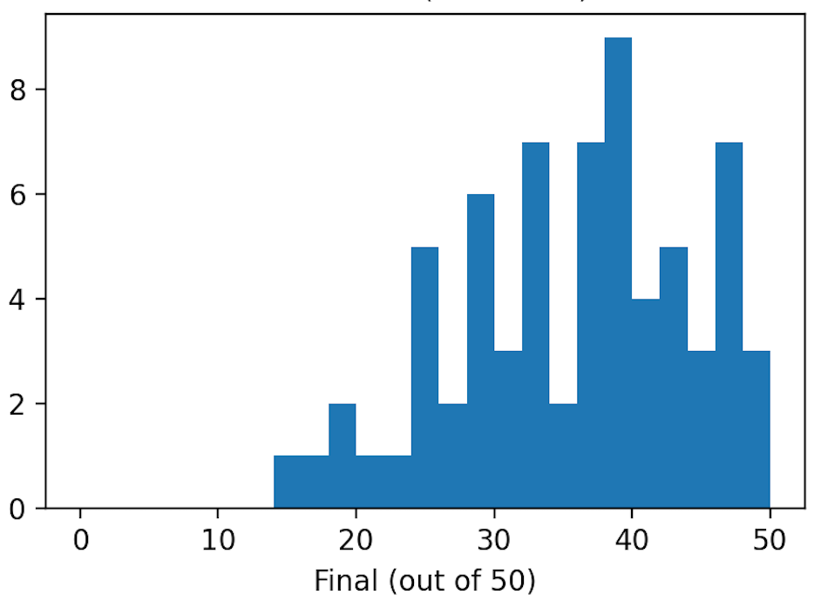
Histograms
We generally plot distributions using “histograms”, which record the number of entries falling within particular ranges.
Example: score on Phy 009D final exam

Slide 5
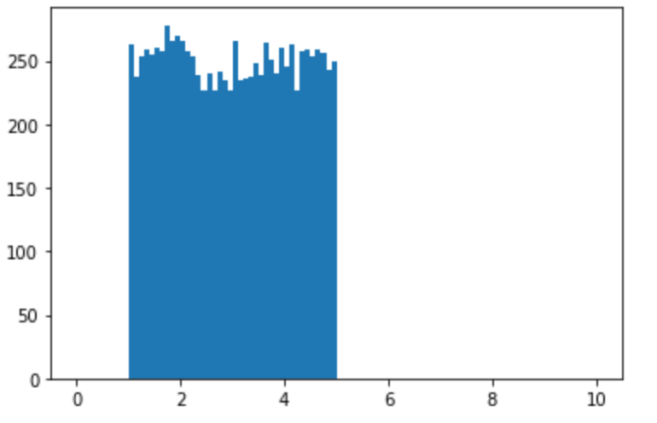
Uniform Probability
A uniform probability is a distribution within a specified range in which every value in the range has an equal probability.
Example: a uniform distribution from 1 to 5

Slide 6
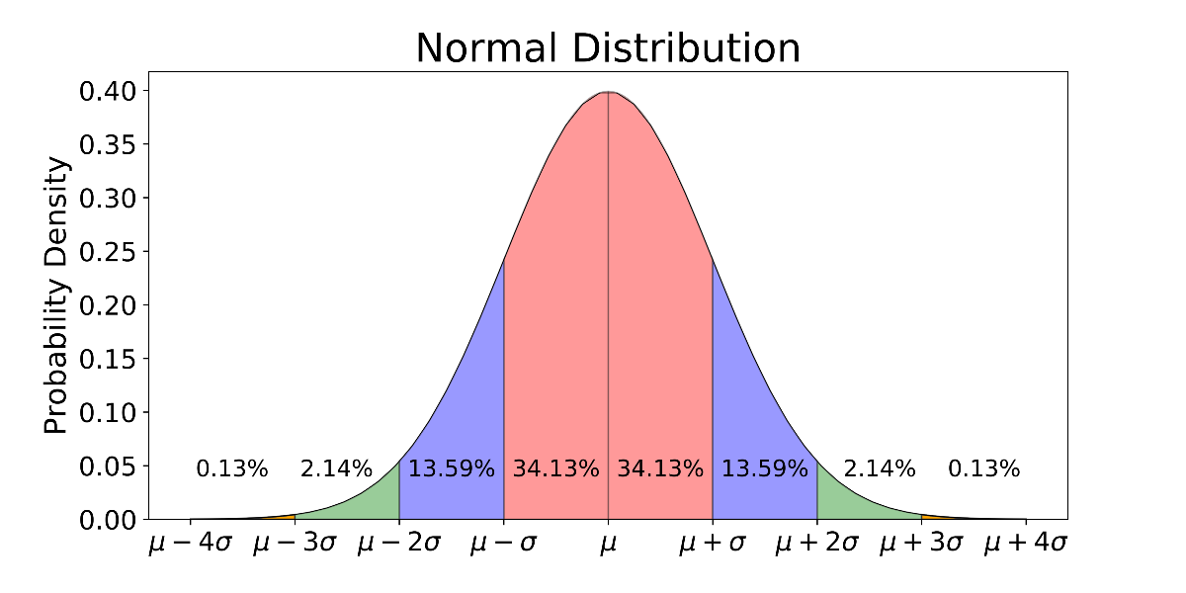
Normal Distribution
A normal (or “Gaussian”) distribution is a probability characterized by a mean (μ) and a standard deviation (σ), according to the following PDF
As we will see, in some limit, all errors can be characterized by this distribution (“central value theorem”)

Slide 7
Random Numbers in Python
The numpy.random package contains a powerful set of routines to generate random numbers, including
Uniform random numbers in a specified range
Distributions based on user-specified probabilities
Normal (Gaussian) distributions
Binomial distributions (we’ll discuss this shortly)
Many, many, more
Without a physical inputs, computers cannot generate truly random numbers. They generate “pseudo-random” numbers, based on a starting ”seed”.
If unspecified, they usually use the unique time as the seed.
If a seed is specified (np.seed(int)), then identical subsequent random number calls will produce identical numbers each time
This can be very important for debugging code!
Do uniform and Gaussian demo…

Slide 8
Binomial Distributions
Let’s imagine I flip a coin 10 times, and it comes up heads 4.
If I look at the first heads, there are 10 possibilities for which throw it came from, 9 for the second, 8, for the third, and 7 for the fourth, for a total of possibilities
But I don’t actually care which throw each came for, so for the first heads there are 4 possibilities that are identical, 3 for the second, the for a total of 4! Indistinguishable “permutations”, so the total number of cases with 4 heads is
Generalizing this, the number of times, we get n_{H} out of N throws is given by
“Binomial coefficient”

Slide 9
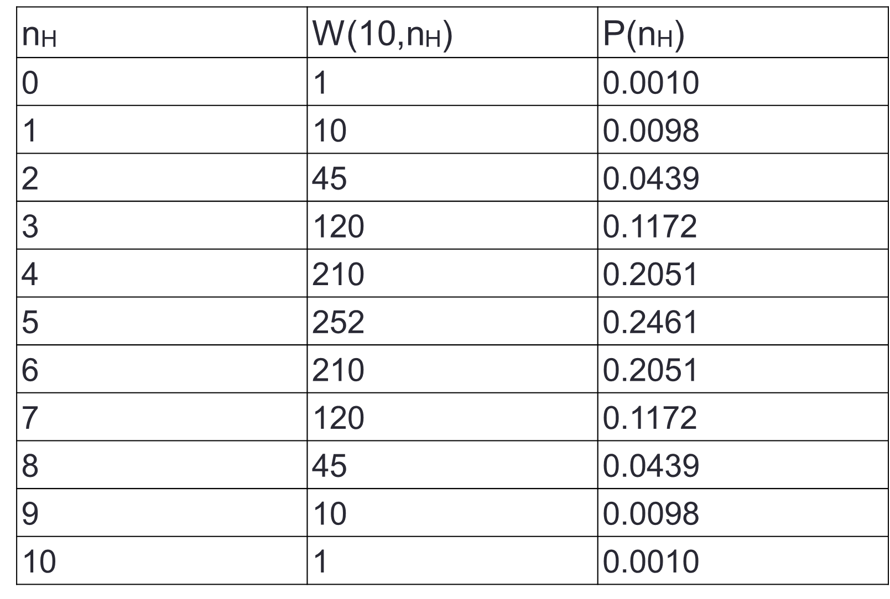
Probabilities
If I flip a coin N times, there are 2^{N} possible unique sequences, so the probability of finding n_{H} after N throws is
For 10 throws, there are 2¹⁰=1024 possible combinations, so the table of probabilities is

Slide 10
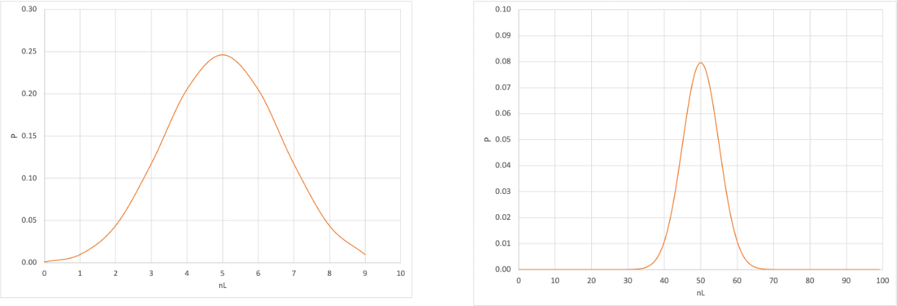
Going to More Throws…
The more throws, the narrower the distribution becomes
Of course, the number of particles in a box is much bigger than 100, so the fraction on the left will be very close to ½ , but will have a distribution.
10 Throws
100 Throws

Slide 11
Generalized Binomial Distribution
In our example, a coin had an equal probability (50%) of coming up heads or tails.
If instead we have two distinct outcomes, A and B, in which the probability of A is p, the probability of B is therefore (1-p), and the normalized binomial distribution is modified as follows
The probability of n_{A} outcomes in state A out of N total trials is
The average value over many trials of N “throws” will be
And the RMS of the distribution will be

Slide 12
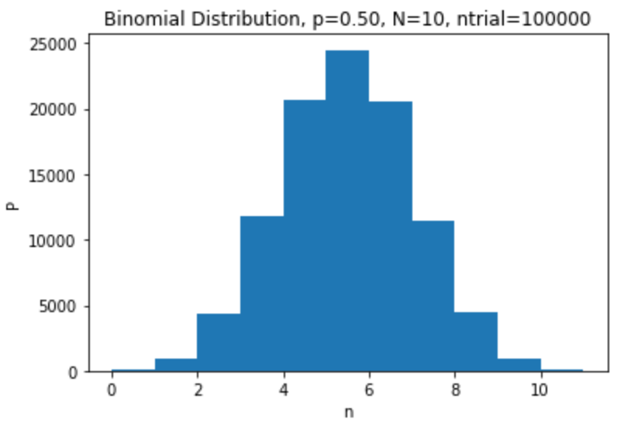
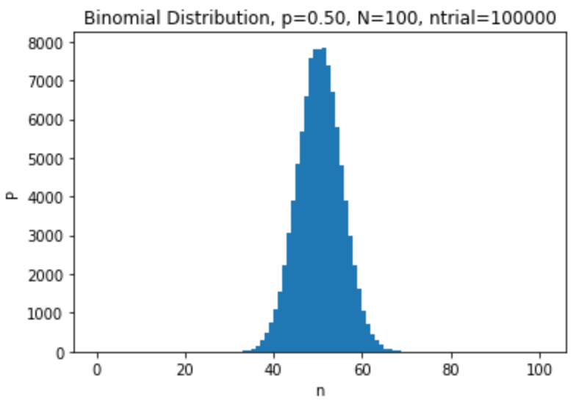
Simulating Binomial Distributions in Python
We will simulate binomial distributions with
numpy.random.binomial(N,p,Ntrial)
For a coin, p=1/2
Number of times I repeat the test. If 1 (or missing), it returns a scalar, otherwise it returns a vector
Number of “throws”
Probability each throw

Slide 13
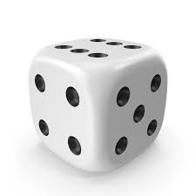
Die Example…
If p is the probability of an event occurring, then the expected number of events for N “throws” is
But what if λ<1?
Example: throwing a 6-sided die three times
The chance of it coming of any particular number, say 4, is 1/6, so the average number of will come up 6 in 3 throw is
Of course, it can’t come up .5 times, it can only come up 0,1,2, or 3 times.

Slide 14
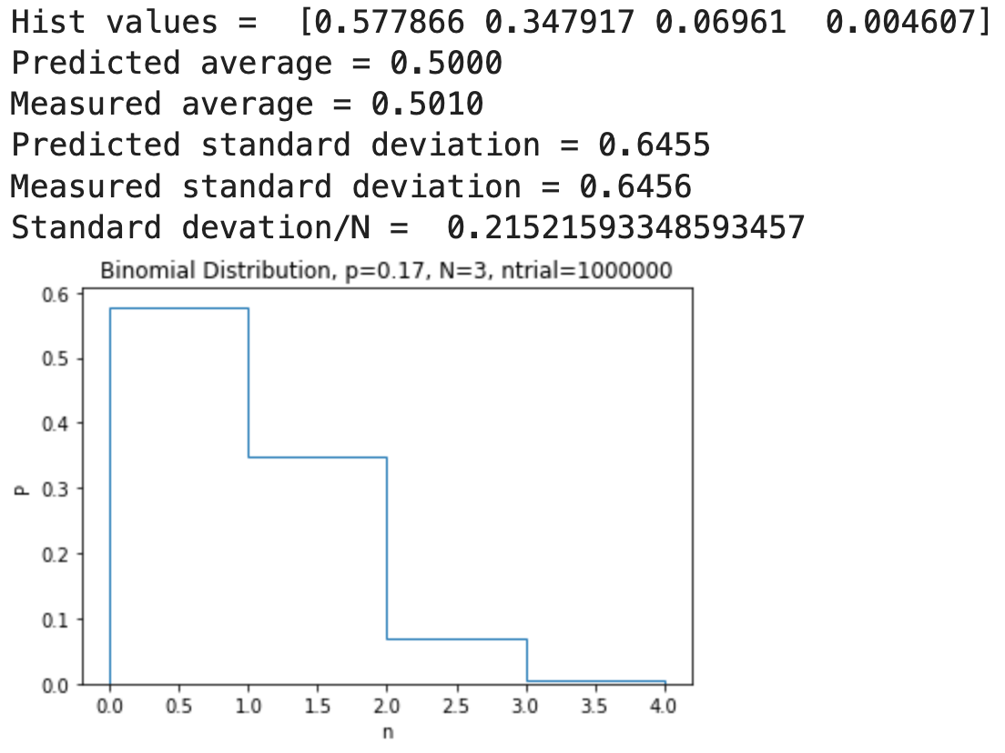
Binomial Distribution for Die Throws
In this case, our options are coming up 4 (p=1/6) or coming up any other number (q=(1-p)=5/6)
The binomial theorem tells is that the probability of coming with 4 a particular number of times is given by

Slide 15
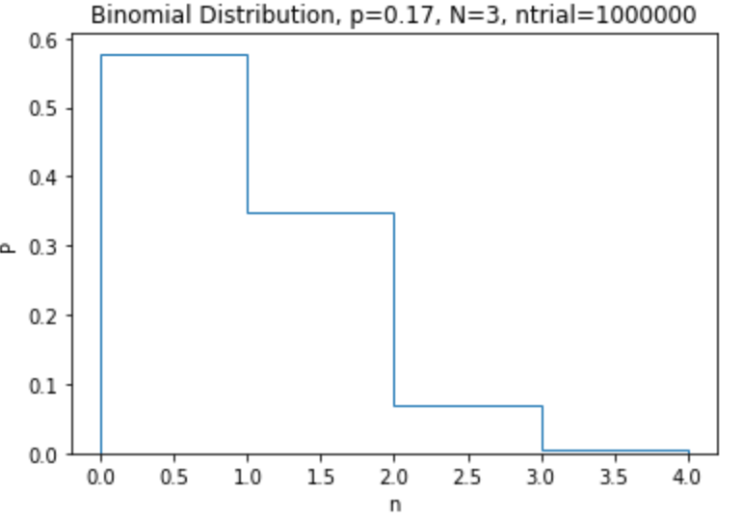
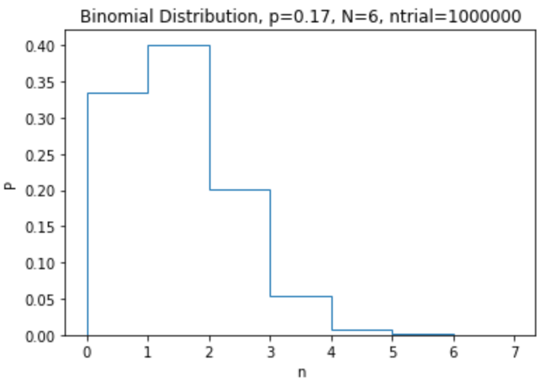
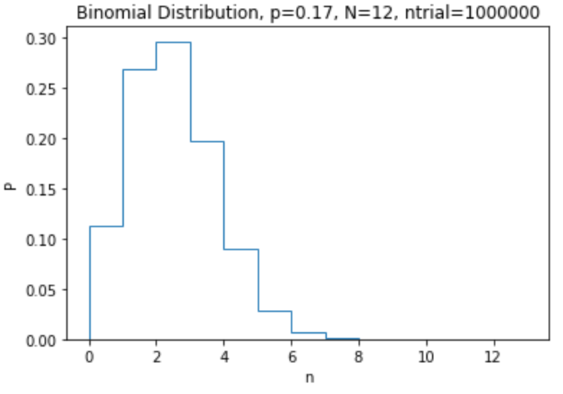
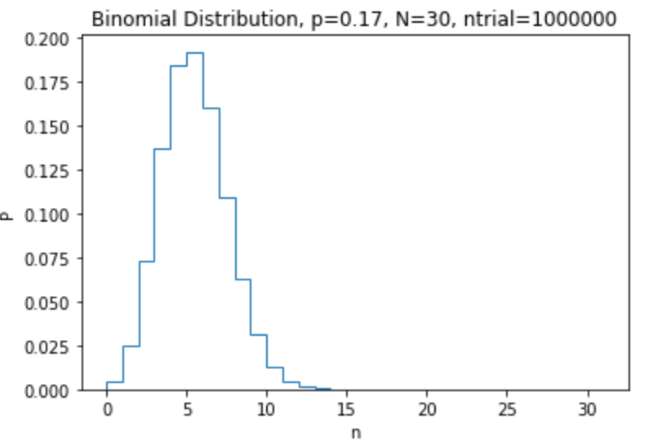
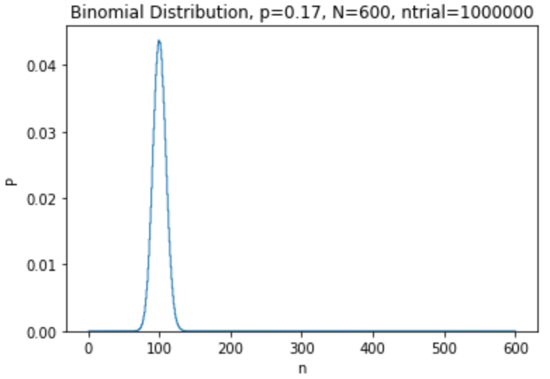
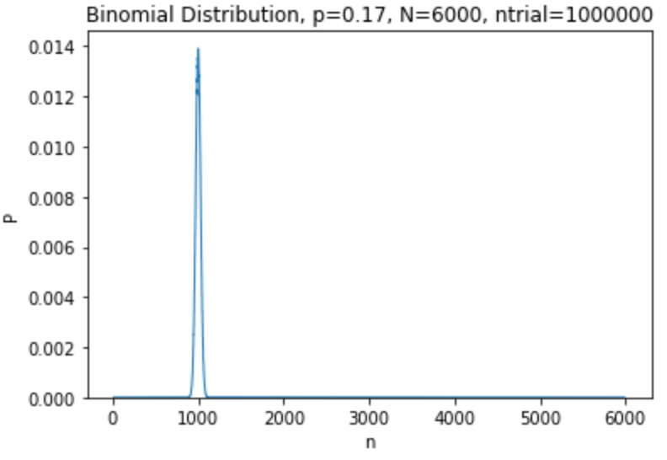
As the Number of Throws Increases
N=3
λ=.5
N=6
λ=1
N=12
λ=2
N=30
λ=5
N=600
λ=100
N=6000
λ=1000

Slide 16
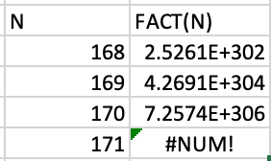
Approximations
The binomial expression is exact, but factorials get problematic pretty fast
Generally, we use two approximations, depending on the expectation values on the counts
“Small statistics” (λ<10): Poisson statistics
Example: throwing a die 3 times
“Large statistics” (λ≥10): Gaussian statistics
Example: flipping a coin at least 10 times
170! is the biggest number that can fit in a 64-bit floating point, and we deal with numbers in the millions, billions, or more

Slide 17
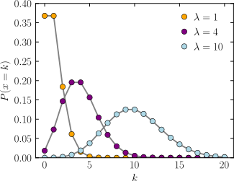
Poisson Distribution
Probability Mass Function
For small statistics (λ<10), the PMF can be approximated by
This equation will also continue to work, but again, these terms will quickly become problematic for large λ
Note the equation becomes symmetric for a λ of 10 or more

Slide 18
Gaussian Distribution
For larger values of l, we can approximate things with a gaussian distribution.

Slide 19
Generating These Distributions Functions in Python
We will use the scipy.stats package
Poisson distribution
scipy.stats.poisson.pmf(k,lam)
PMF designed for discrete integer points
Gaussian (normal) distribution
scipy.stats.norm.pdf(x,loc=mean,scale=sigma)
PDF is a continuous function
strictly speaking, we should integrate it over each integer value, but we usually won’t do that
“probability mass function”
Point or array of points
λ
“probability density function”
λ
σ
Point or array of points

Slide 20
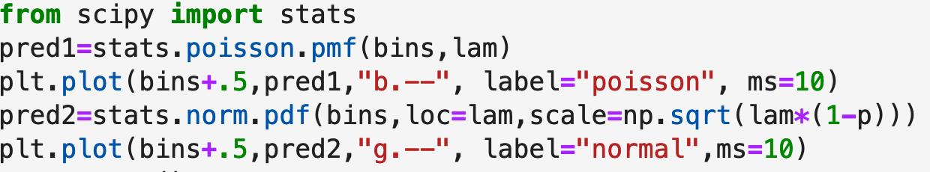
Plotting
We will plot the predictions for both distributions with the following commands
Marker size
Move to middle of bin
Dashed line (one dash would be solid)
Color (g=greem,b=blue)
Markers at each point

Slide 21
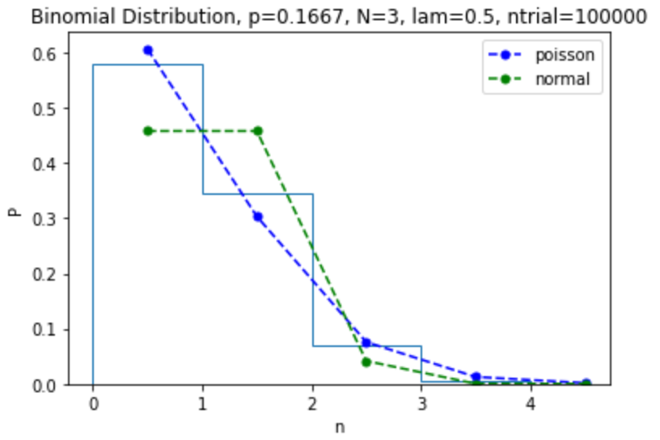
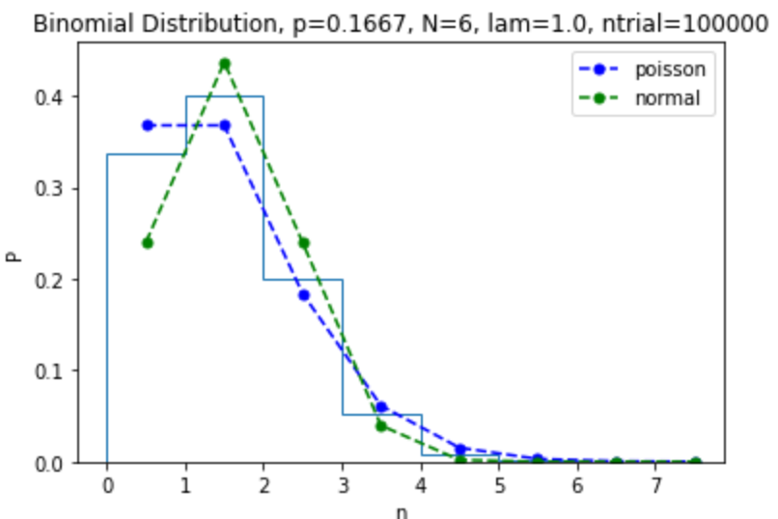
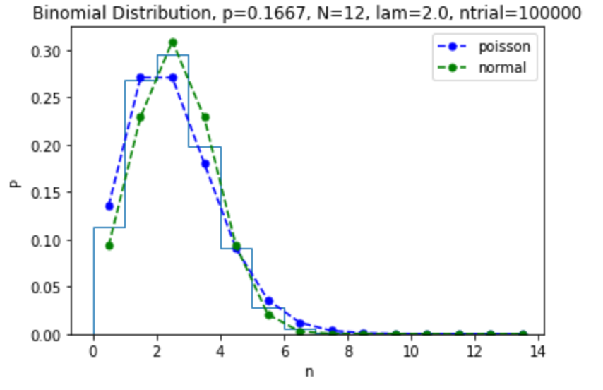
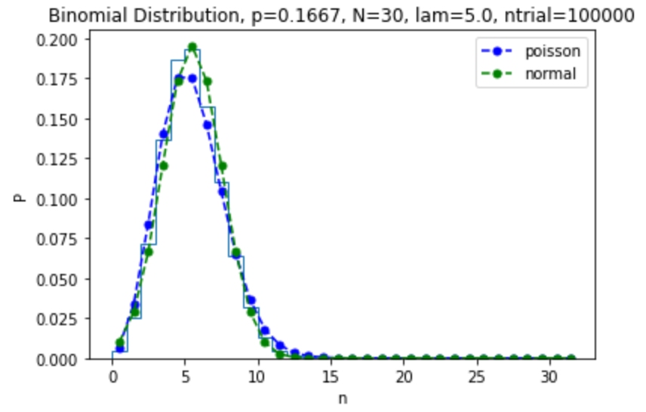
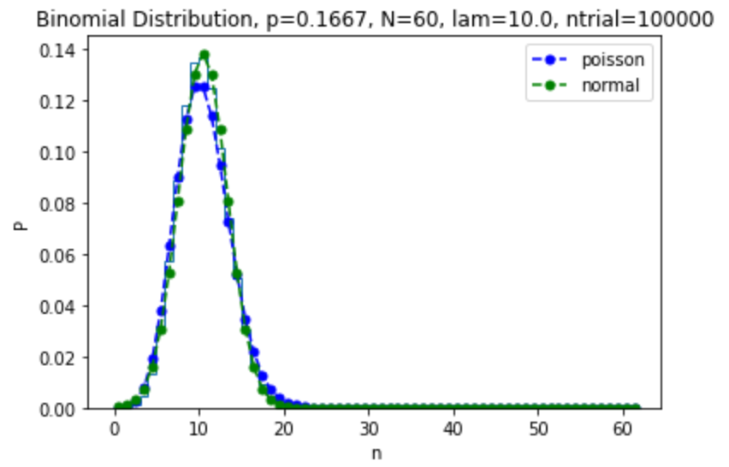
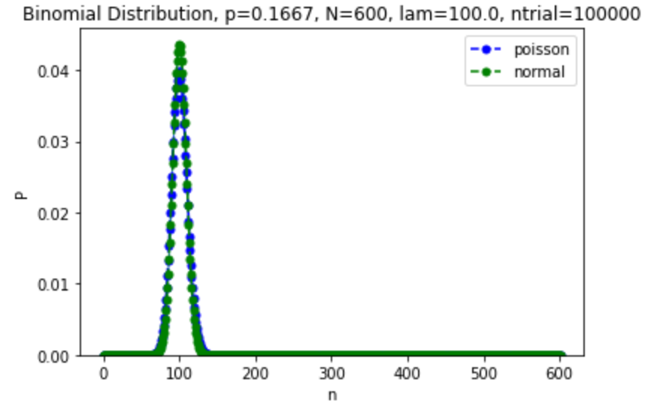
Back to Dice

Slide 22
Example
Generally, we only make a single trial for N throws, and these distributions tell us how accurate it will be.
We’ve been starting with things we know to make distributions, but in the real world, we’ll usually make distributions to learn things we don’t know.
Example: how many times do I have to throw a die to prove it’s “honest”?
We’ll define “honest” to be that the probability of getting each number really is 1/6 to within 1%
How many throws to I have to make before the RMS on the predicted value of n is 1% of its predicted value?
Note: I can keep track of all the numbers simultaneously in this experiment.

Slide 23
Test
If the dice are accurate, then the average number I should get with N throws is
And the RMS is
My goal is for this to be a certain fraction of n, so…

Slide 24
So if my goal is a particular uncertainty Δ, then we need at least
This means that if I roll the die 50,000 times, the fraction of the time it will come up a particular number, say 2, will be distributed according to a Gaussian probability of mean 1/6 and RMS 1/6*.01 = 1/600

Slide 25
I I measure a value 2s away, there’s on a 5% probability it’s from random chance
I can decide how good is good enough, i.e. how big a deviation I’ll allow
How many good dice am I willing to throw away?
Note: there are probably better ways to test dice!

Slide 26
Cumulative Density (or Mass) Functions
For any probability distribution, we can define the ``Cumulative Density function as the integral up to a particular value.
So we can get the probability of falling between any two points as

Slide 27
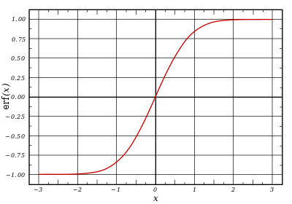
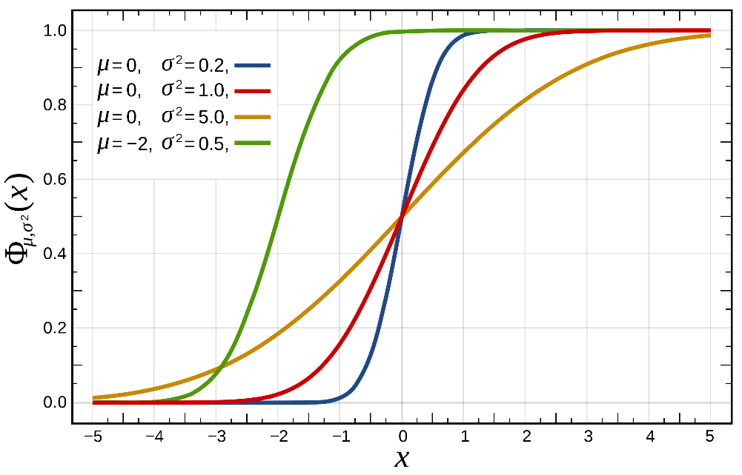
CDF for a Gaussian
Unfortunately, the indefinite integral of a Gaussian is not defined, so we define it in terms of the “error function” (erf())

Slide 28
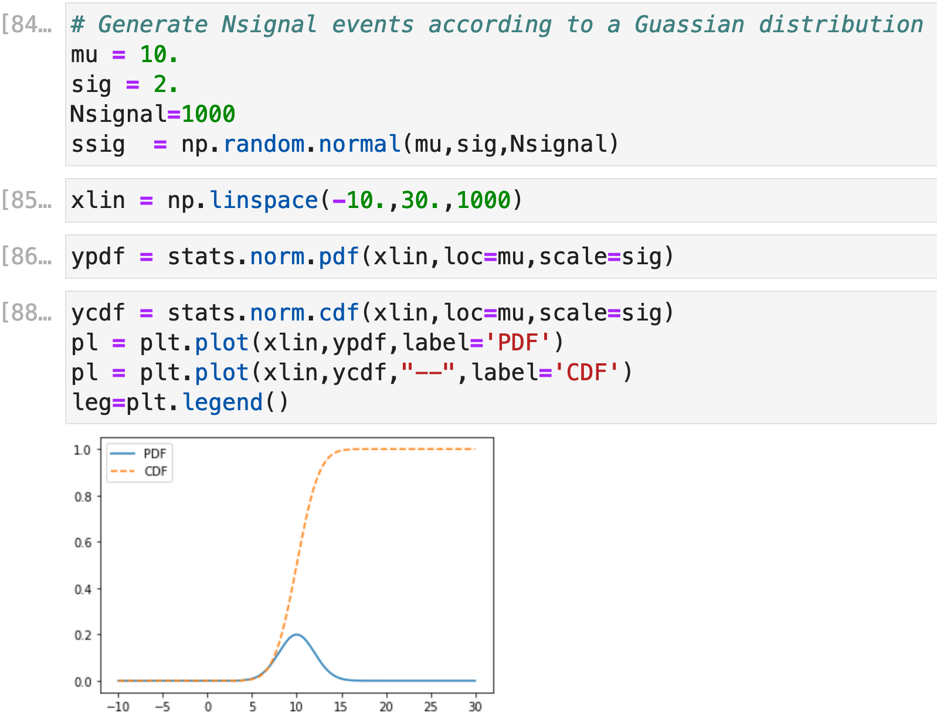
Gaussian CDF in Python
In Python, the CDF is extracted through the cdf method of stats.norm

Slide 29
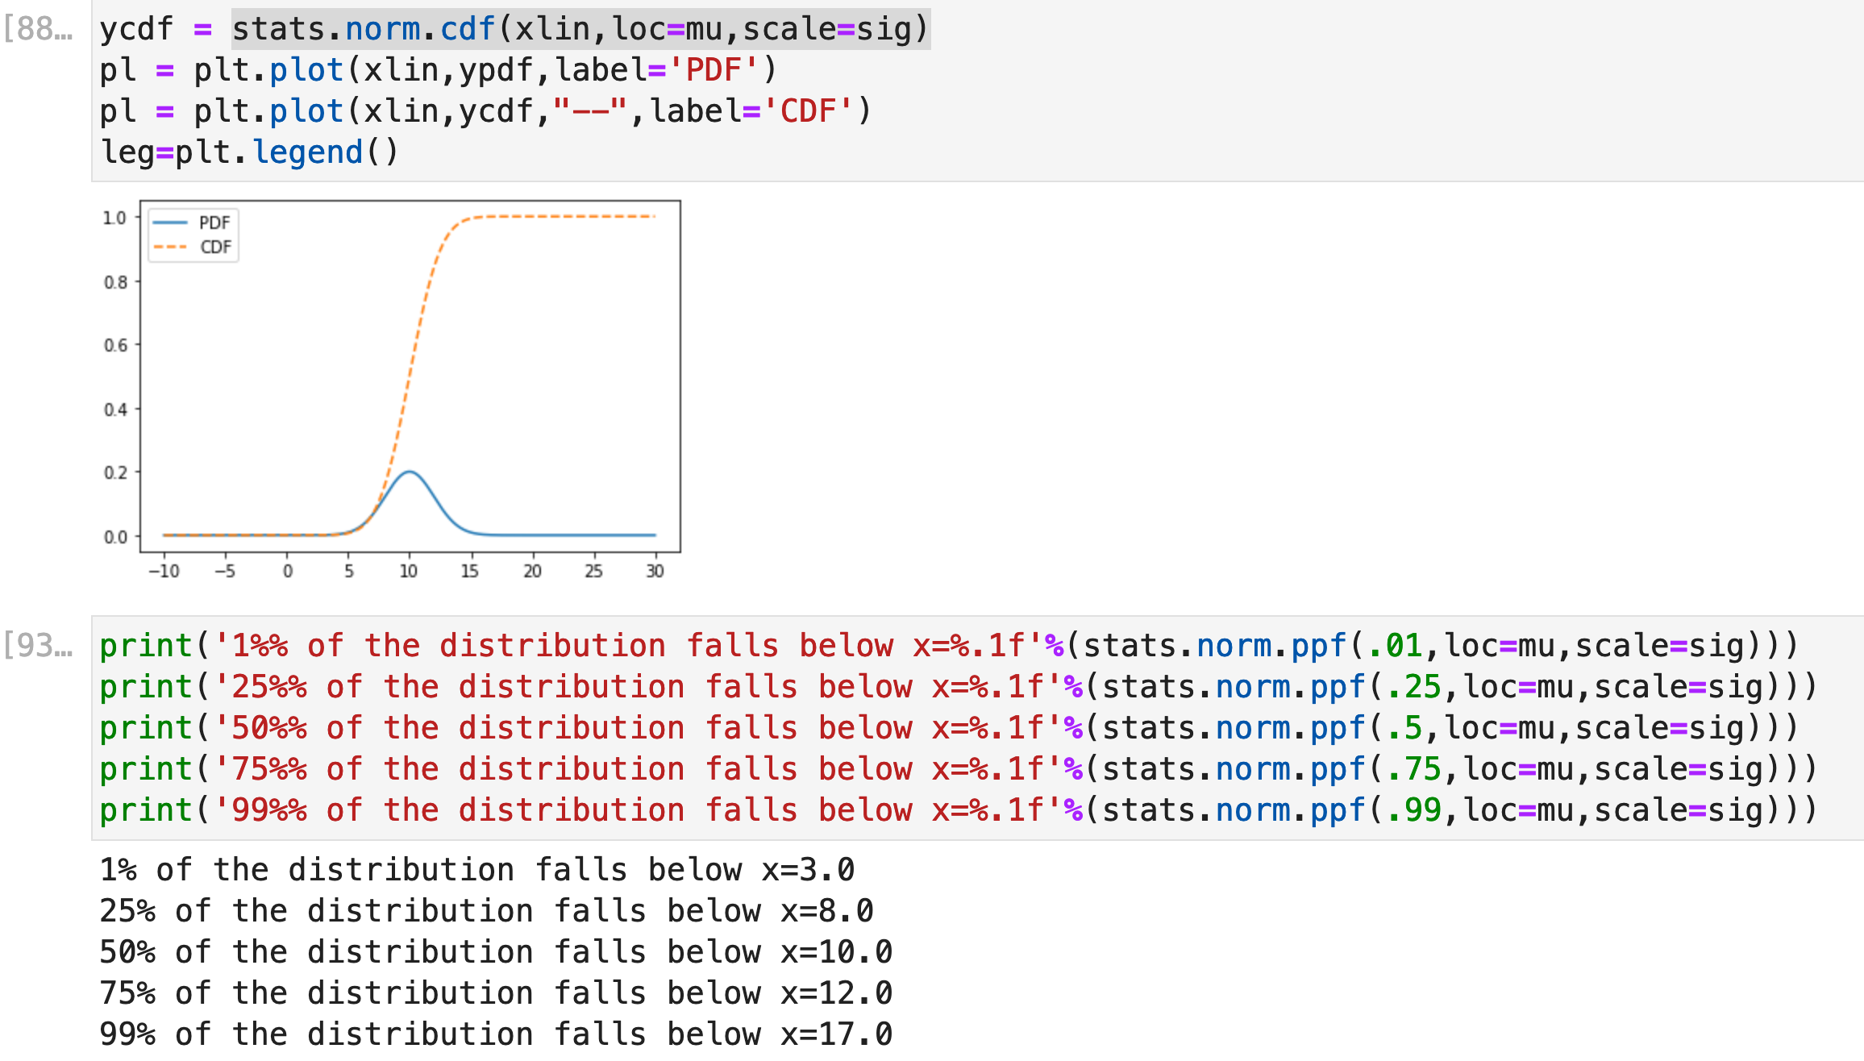
Inverse CDF -> Percentage Point Function
x=PPF(p) is the point in x which a fraction p of the distribution falls below.
In Python, this is given by the ppf method in the stats package

Slide 30
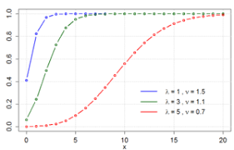
Cumulative Mass Function for Poisson Dist.
Because the Poisson distribution is discrete, we talk about cumulative mass rather than density

Slide 31
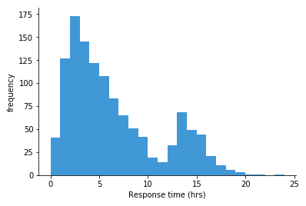
Error on Histogram Bin Contents
If entries are distributed over many histogram bins, we can look at any single bin and consider the binary choice between that bin an all other bins.
Probability that an event will land in bin i.
If there are N events total, then the expected number of events in each bin will be λ_{i}=p_{i}N.
The RMS of the number will be
If there are many bins, then p<<1 and
Number of events observed in bin i.

Slide 32
Limit of Small Statistics
We generally set the error on the contents of a bin as the square root on the number of the events observed in the bin.
This isn’t really accurate when the number of events in the bin is small (say <5).
In particular, if there are no events in the bin, this would say
This will cause any fit to fail if it can’t go exactly through the point.
If we have a small number of bins with zero, we typically set the error to 1.
If there are a significant number of bins with zero, we need to use a different approach to fitting.
No error on point!

Slide 33
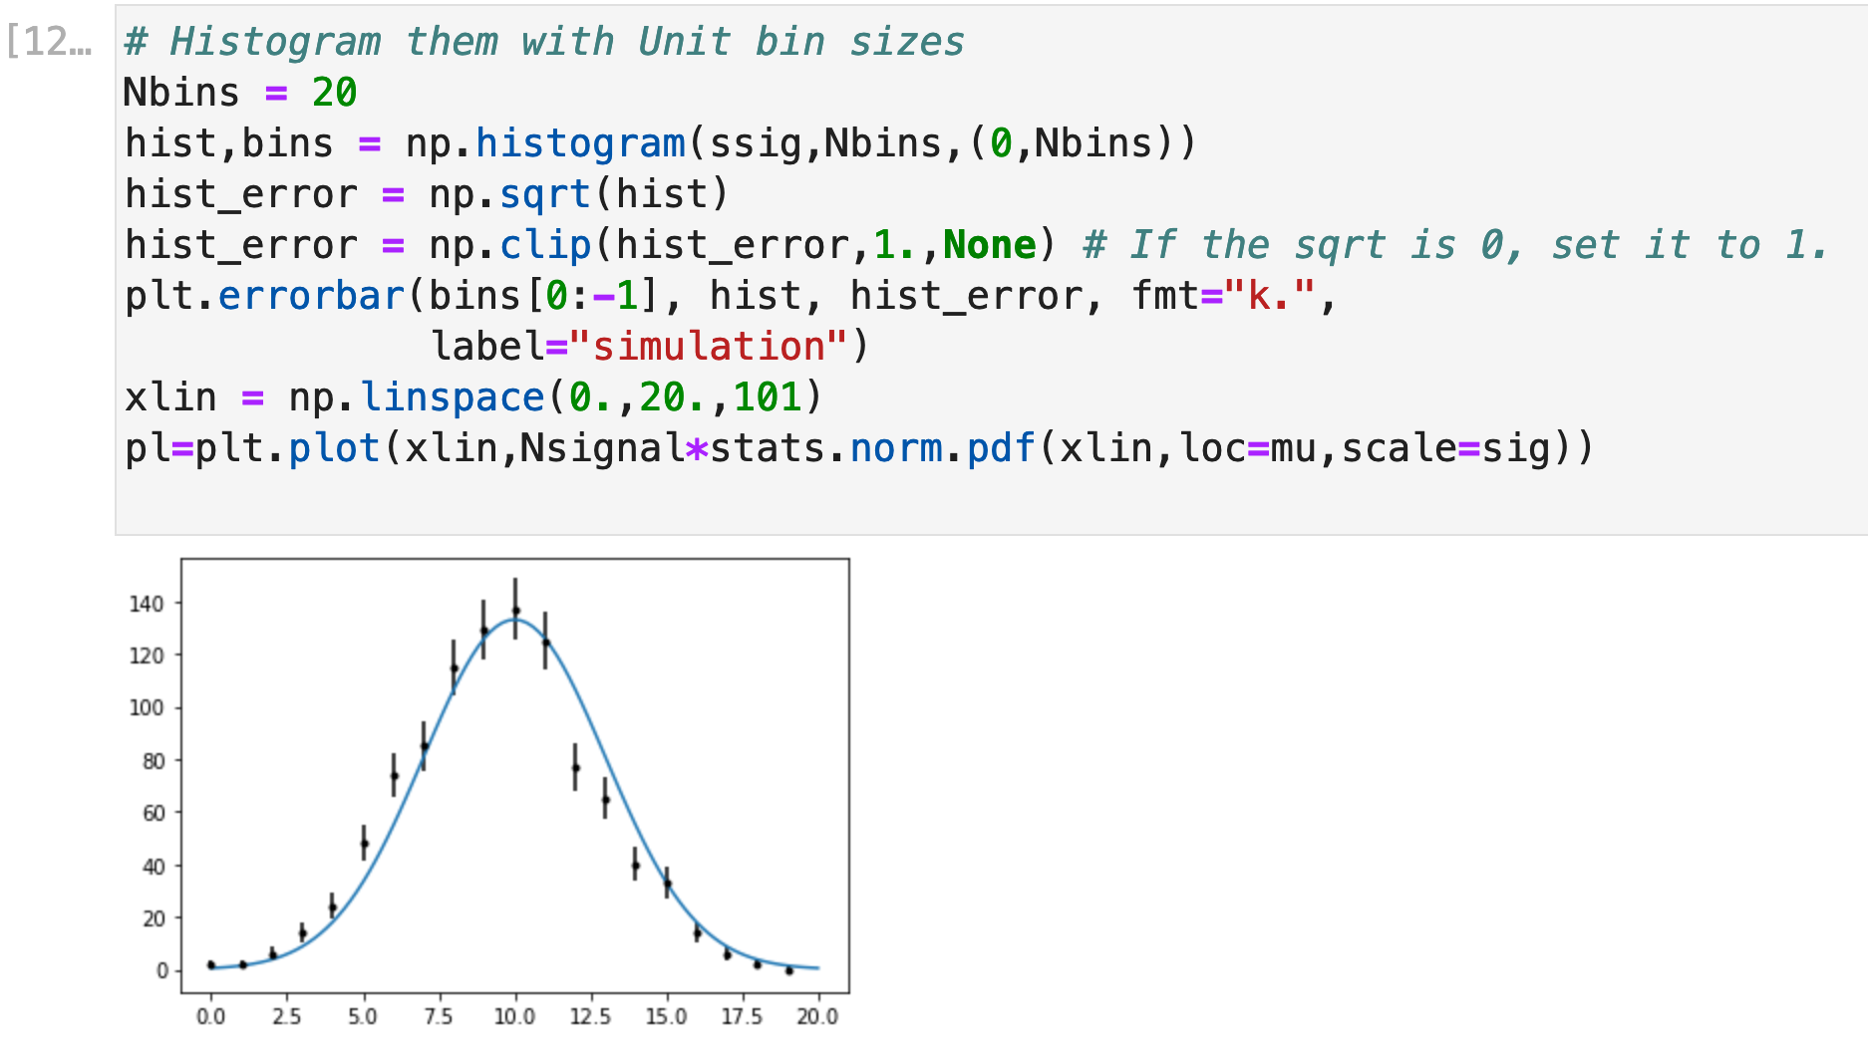
Plotting a Histogram with Errors
If we want to get fancy, better to use numpy.histogram rather than plt.histogram.
Scale the normal function by the number of events.
The errors look about right, but something is wonky about the position. It looks shifted. Why?

Slide 34
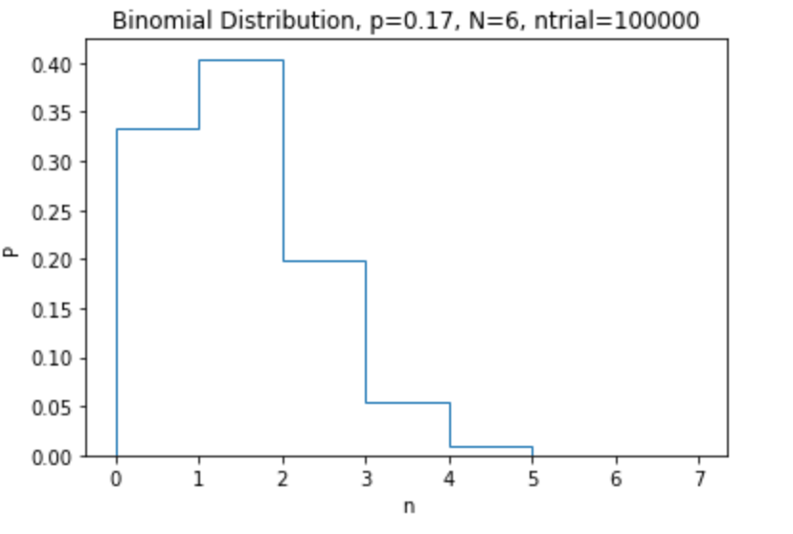
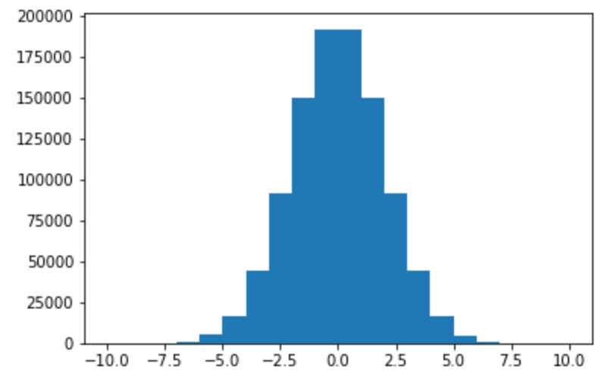
Location of the Bin
In most of the examples we’ve done, we’ve been histogramming integers into unit bins, so the location of our entries is always the left side of the bin, which we get with bins[:-1] (the last entry in bins is the final right location)
On the other hand, the normal distribution is a continuous variable, in which the values are distributed ~uniformly over the bin.
Makes more sense to put the location in the center of the bin.

Slide 35
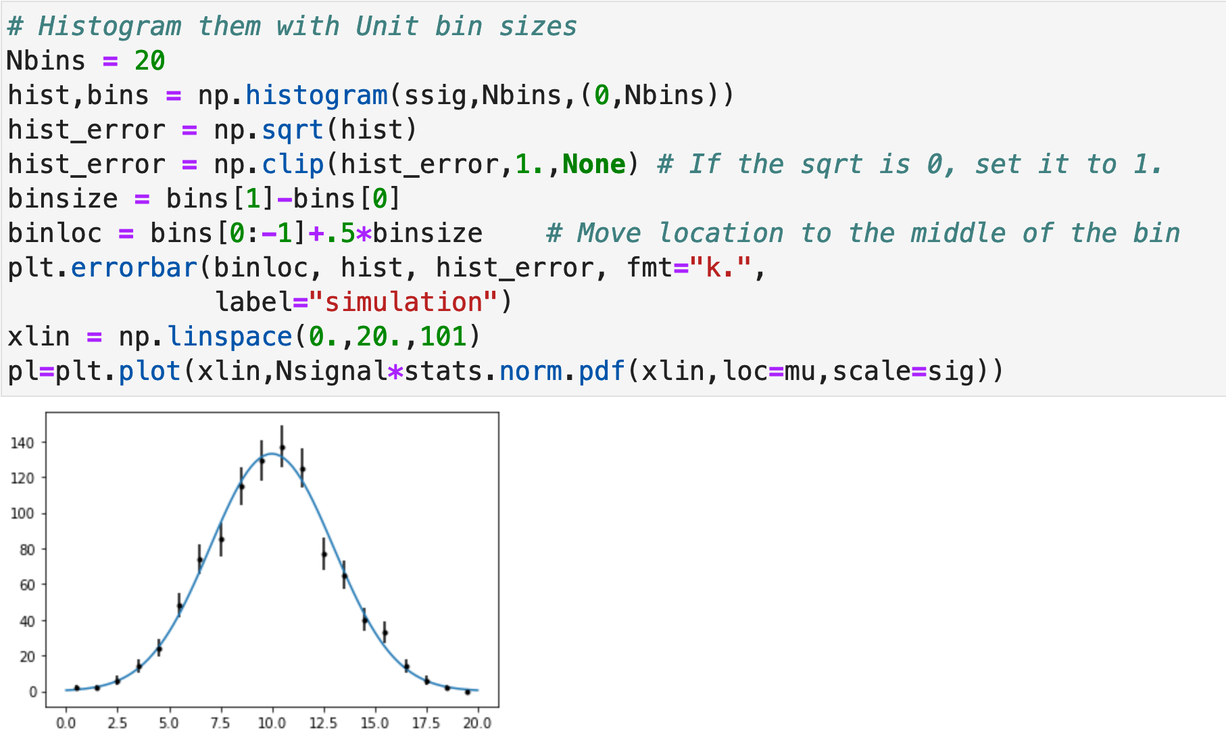
Fixing Our histogram

Slide 36
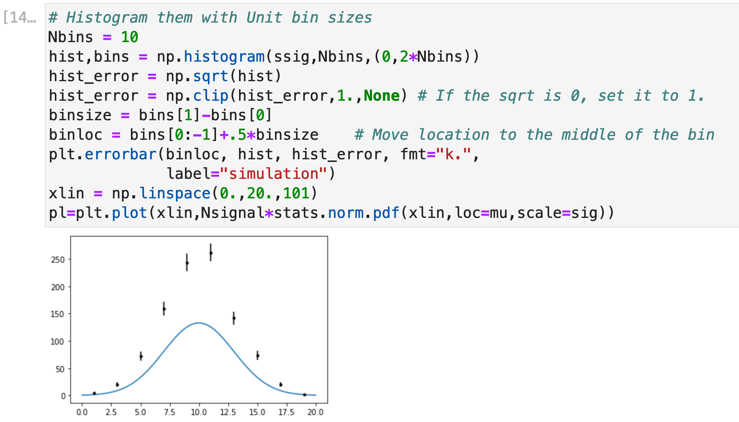
Normalizing Histograms (Important Concept!)
In case you haven’t noticed, in most of our examples, we’ve always made our bin size 1. What happens if we change that. Let’s redo the last histogram with a bin size of 2
What happened?
We added pairs of bins together, which doubled their contents, but my physics shouldn’t depend on how I bin things.
How can I present things in a consistent way?

Slide 37
Our PDF is defined by the normalization condition
The probability of something landing in a particular bin is
If I divide the bin contents (and the error!) by the size of the bin, I should get a result that’s independent of bin size.
Average value over the bin

Slide 38
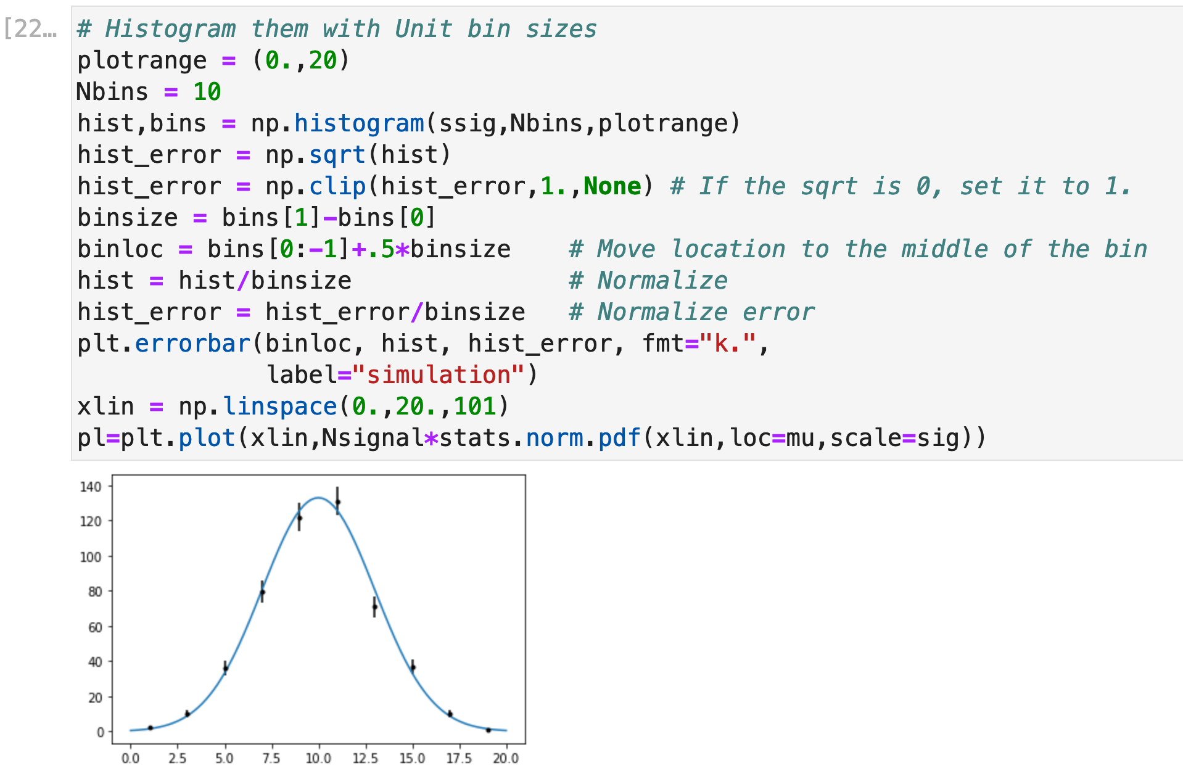
Check

Slide 39
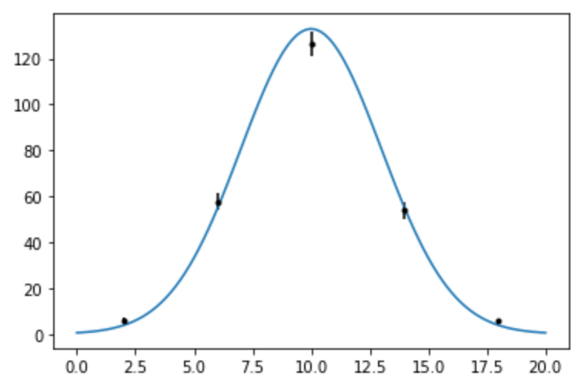
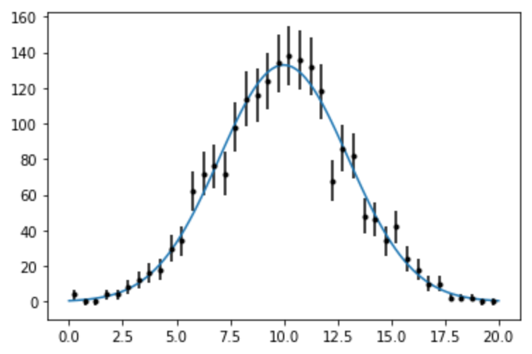
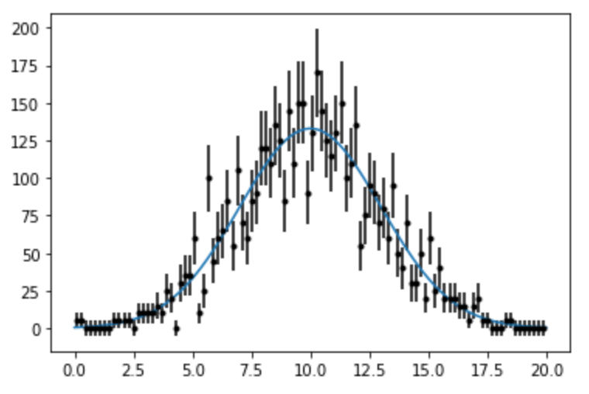
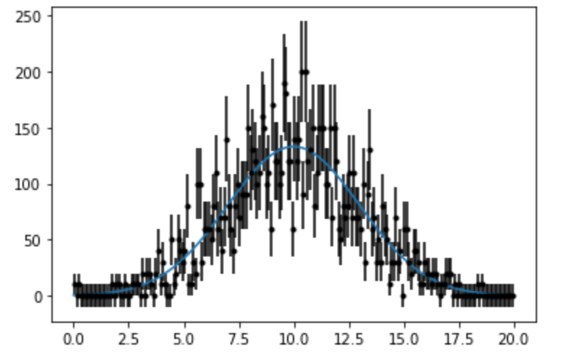
Other Binnings
5
40
100
200

Slide 40
Arbitrary Distributions
In many cases, we want to generate a distribution based on an arbitrary parametrization.
Example, simulating background to a physics signal
In this case, we can use a “Monte Carlo” technique to simulate any distribution

Slide 41
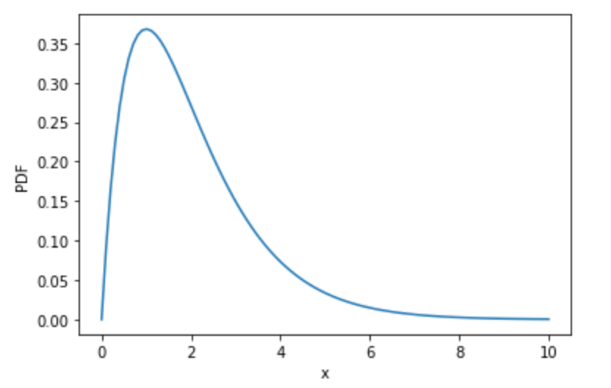
Procedure
max
Example:
Step 0: Choose a range for your random numbers
Step 1: Generate a random value of x which is uniformly distributed over the range.
Step 2: Evaluate the PDF at this point
Step 3: Is the PDF value at this point greater than a random number between 0 and that maximum value of the function?
Yes? Return the value of x
No? Go back to step 1
range

Slide 42
Example
Normalization only important for plotting against our results!
Generate random numbers with a distribution
It looks like a range of 0 to 10 is reasonable, so let’s code this up…

Slide 43
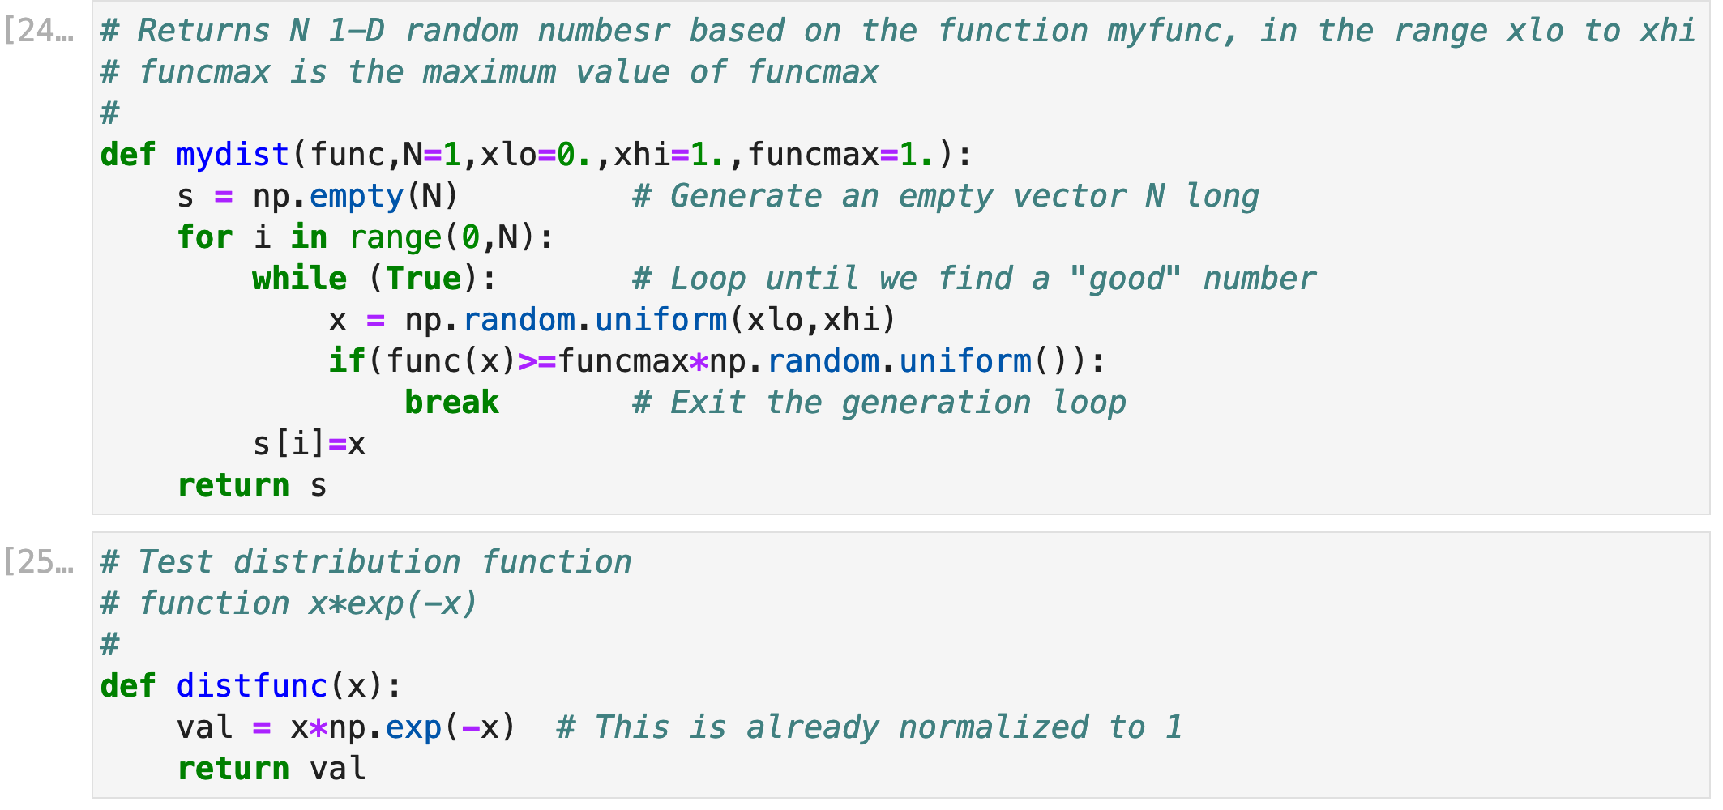
Example Functions

Slide 44
